Slide 1
CSE / T / 423C
Distributed Computing
Topic 10: Synchronization and Coordination
Sarbani Roy
Department of Computer Science & Engineering
Jadavpur University
E-mail: sarbani.roy@jadavpuruniversity.in
Room: CC-5-7
Phone: 9051639328

Slide 2
Synchronization & Coordination
One of the fundamental issues encountered when constructing a system made up of independent communicating processes: dealing with time and making sure that processes do the right thing at the right time.
In essence this comes down to allowing processes to synchronize and coordinate their actions.
  Coordination refers to coordinating the actions of separate processes relative to each other and allowing them to agree on global state (such as values of a shared variable). Examples of coordination include ensuring that processes agree on what actions will be performed, who will be performing actions, and the state of the system.
  Synchronization is coordination with respect to time, and refers to the ordering of events and execution of instructions in time. Examples of synchronization include ordering distributed events in a log file and ensuring that a process performs an action at a particular time.
BCSE-IV 2nd Sem
Distributed Computing

Slide 3
Synchronization and coordination
Synchronization and coordination play an important role in most distributed algorithms (i.e., algorithms intended to work in a distributed environment).
In particular, some distributed algorithms are used to achieve synchronization and coordination, while others assume the presence of synchronization or coordination mechanisms.
Distributed algorithms generally assume one of two timing models for distributed systems.
  The first is a synchronous model, where the time to perform all actions, communication delay, and clock drift on all nodes, are bounded.
  In asynchronous distributed systems there are no such bounds. Most real distributed systems are asynchronous, however, it is easier to design distributed algorithms for synchronous distributed systems. Algorithms for asynchronous systems are always valid on synchronous systems, however, the converse is not true.
BCSE-IV 2nd Sem
Distributed Computing

Slide 4
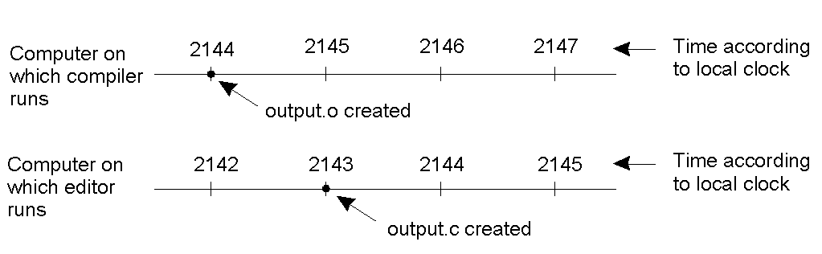
Clock Synchronization
When each machine has its own clock, an event that occurred after another event may nevertheless be assigned an earlier time.
BCSE-IV 2nd Sem
Distributed Computing

Slide 5
Time & Clocks
In particular it is often important to know when events occurred and in what order they occurred.
In a non-distributed system dealing with time is trivial as there is a single shared clock. All processes see the same time.
In a distributed system, on the other hand, each computer has its own clock. Because no clock is perfect each of these clocks has its own skew which causes clocks on different computers to drift and eventually become out of sync.
There are several notions of time that are relevant in a distributed system. First of all, internally a computer clock simply keeps track of ticks that can be translated into physical time (hours, minutes, seconds, etc.).
  This physical time can be global or local. Global time is a universal time that is the same for everyone and is generally based on some form of absolute time
  Currently Coordinated Universal Time (UTC), which is based on oscillations of the Cesium-133 atom, is the most accurate global time.
  Besides global time, processes can also consider local time. In this case the time is only relevant to the processes taking part in the distributed system (or algorithm). This time may be based on physical or logical clocks.
BCSE-IV 2nd Sem
Distributed Computing

Slide 6
Clock skew & drift
Skew: instantaneous difference bet. readings
Drift: different rates of counting time
  physical variations of underlying oscillators
  variance with temperature
  Even extremely small differences accumulate over a large number of oscillations
    leading to observable difference in the counters
  drift rate: difference in reading bet. a clock and a nominal “perfect clock” per unit of time measured by the reference clock
    10⁻⁶ seconds/sec for quartz crystals
    10⁻⁷ ⁻ 10⁻⁸ seconds/sec for high precision quartz crystals
BCSE-IV 2nd Sem
Distributed Computing

Slide 7
Physical Clocks
Physical clocks keep track of physical time. In distributed systems that rely on actual time it is necessary to keep individual computer clocks synchronized. The clocks can be synchronized to
  global time (external synchronization), Cristian’s algorithm and the Network Time Protocol (NTP) are examples of algorithms developed to synchronize clocks to an external global time source (usually UTC).
  or each other (internal synchronization),The Berkeley Algorithm is an example of an algorithm that allows clocks to be synchronized internally.
BCSE-IV 2nd Sem
Distributed Computing

Slide 8
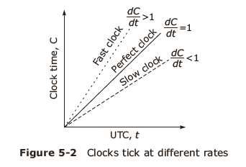
Drifting of computer clocks

Slide 9
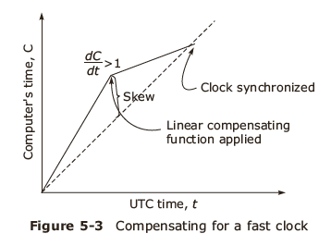
Synchronization using real time clocks
UTC
Mutual synchronization among clocks within the system

Slide 10
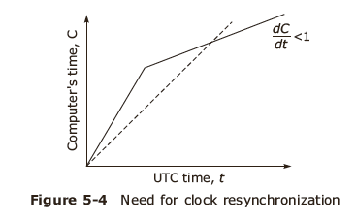
Issues in clock synchronization
Ability for each node to read the other node’s clock value
Time must never run backwards

Slide 11
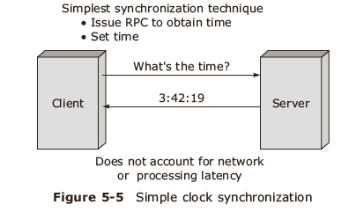
Simple Clock synchronization

Slide 12
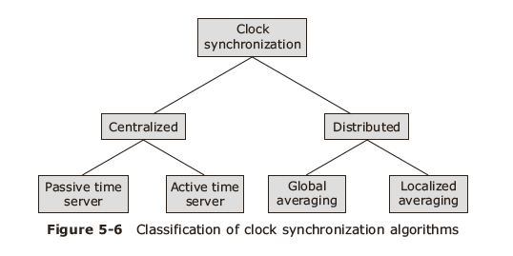
Clock synchronization

Slide 13
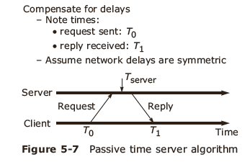
Centralized algorithms-1
Passive time server

Slide 14
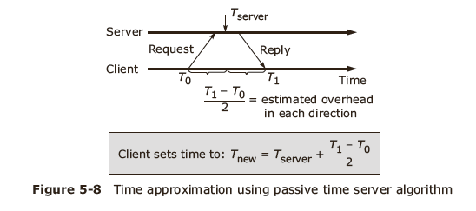
Centralized algorithm-2

Slide 15
Cristian’s algorithm
Cristian’s algorithm requires clients to periodically synchronize with a central time server (typically a server with a UTC receiver).
One of the problems encountered when synchronizing clocks in a distributed system is that unpredictable communication latencies can affect the synchronization.
  For example, when a client requests the current time from the time server, by the time the server’s reply reaches the client the time will have changed. The client must, therefore, determine what the communication latency was and adjust the server’s response accordingly.
  Cristian’s algorithm deals with this problem by attempting to calculate the communication delay based on the time elapsed between sending a request and receiving a reply.
BCSE-IV 2nd Sem
Distributed Computing

Slide 16
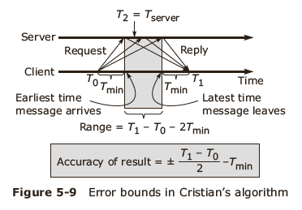
Centralized algorithm-3
Cristian’s method

Slide 17
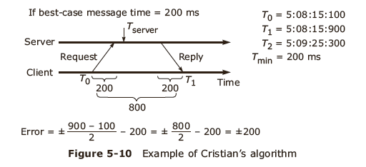
Centralized algorithm-4

Slide 18
Berkeley algorithm
Unlike the previous algorithm, the Berkeley algorithm does not synchronize to a global time.
Instead, in this algorithm, a time server polls the clients to determine the average of everyone’s time.
The server then instructs all clients to set their clocks to this new average time.
Note that in all the above algorithms a clock should never be set backward. If time needs to be adjusted backward, clocks are simply slowed down until time ’catches up’.
BCSE-IV 2nd Sem
Distributed Computing

Slide 19
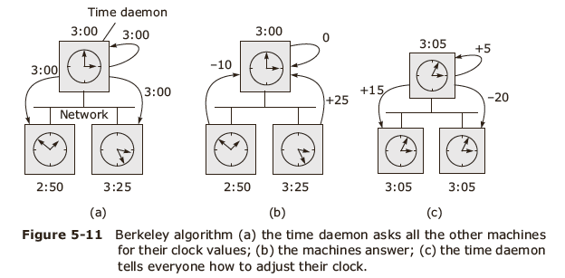
Active time server centralized algorithm
Berkeley algorithm

Slide 20
Distributed algorithms
Characteristics
  Relevant information is distributed across machines
  Processes make decisions based only on local information
  Single points of failure must be avoided
  No common or global clock is available
Global averaging distributed algorithm
Localized averaging distributed algorithm

Slide 21
Network Time Protocol
The Network Time Protocol is similar to Cristian’s algorithm in that synchronisation is also performed using time servers and an attempt is made to correct for communication latencies.
Unlike Cristian’s algorithm, however, NTP is not centralised and is designed to work on a wide area scale. As such, the calculation of delay is somewhat more complicated.
Furthermore, NTP provides a hierarchy of time servers, with only the top layer containing UTC clocks. The NTP algorithm allows client-server and peer-to-peer (mostly between time servers) synchronization. It also allows clients and servers to determine the most reliable servers to synchronize with.
NTP typically provides accuracies between 1 and 50 msec depending on whether communication is over a LAN or WAN.
BCSE-IV 2nd Sem
Distributed Computing

Slide 22
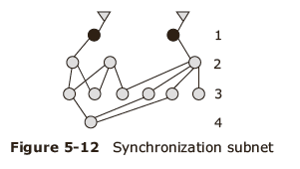
Network time Protocol
Synchronization Modes
  Multicast mode
  Procedural call mode
  Symmetric mode

Slide 23
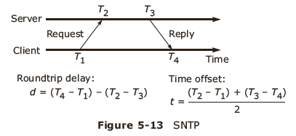
Simple Network Time Protocol-1

Slide 24
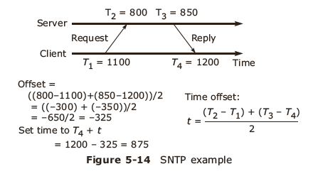
Simple Network Time Protocol-2

Slide 25
Logical clocks

Slide 26
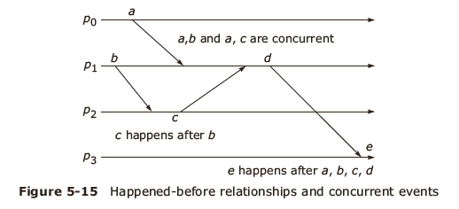
Event ordering
Happened before relation
Causal ordering

Slide 27
Lamport’s idea of logical clocks
Processes that don't interact don't matter (need a common clock)
Event ordering is key, rather than true time
Absolute correctness is less important than consistency (logical versus physical clocks)

Slide 28
Implementation of Logical Clocks
Conditions for correct functioning:
C1: If a and b are two events in the same process, and a→ b, then we demand that C(a) < C(b).
C2: If a corresponds to sending a message m, and b corresponds to receiving that message, then also C(a) < C(b).
C3: A clock C associated with the process P must always go forward, never backwards. Hence corrections to a logical clock must be always made by adding a positive value , never subtracting from it.

Slide 29
Lamport’s Implementation Rules
IR1:
  Each process P increments C by any two successive events. This IR ensures that condition C1 is satisfied.
IR2:
  If event a is sending of a message m by process P, the message m contains a timestamp Tm- C(a) and upon receiving the message m by another process P, it sets its clock C to a value greater or equal to its present value but greater than Tm. This IR ensures that condition C2 is met.

Slide 30
Logical Clocks
For many applications, the relative ordering of events is more important than actual physical time.
  In a single process the ordering of events (e.g., state changes) is trivial.
  In a distributed system, however, besides local ordering of events, all processes must also agree on ordering of causally related events (e.g., sending and receiving of a single message).
Given a system consisting of N processes pi, i belongs to {1, . . . ,N}, we define the local event ordering →i as a binary relation, such that,
if pi observes e before e′, we have e →i e′.
Based on this local ordering, we define a global ordering as a happened before relation →, as proposed by Lamport.
  The relation → is the smallest relation, such that
    e →i e′ implies e → e′,
    for every message m, send(m) → receive(m), and
    e → e′ and e′ → e′′ implies e → e′′ (transitivity).
BCSE-IV 2nd Sem
Distributed Computing

Slide 31
Lamport Clocks
Lamport’s logical clocks can be implemented as a software counter that locally computes the happened-before relation →.
This means that each process pi maintains a logical clock Li. Given such a clock, Li(e) denotes a Lamport timestamp of event e at pi and L(e) denotes a timestamp of event e at the process it occurred at. Processes now proceed as follows:
  Before time stamping a local event, a process pi executes Li := Li + 1.
  Whenever a message m is sent from pi to pj :
    Process pi executes Li := Li + 1 and sends the new Li with m.
    Process pj receives Li with m and executes Lj := max(Lj ,Li) + 1. receive(m) is annotated with the new Lj.
BCSE-IV 2nd Sem
Distributed Computing

Slide 32
Maintaining Lamport’s logical clocks.
  Sending a message m from P_{i} to P_{j}.
    P_{i} executes L_{i} ← L_{i} + 1.
    Sets m’s timestamp ts(m) equal to C_{i}.
    Deliver to network.
  Receiving the message m from P_{i} at P_{j}.
    Network receives the message m and delivers to the middleware layer.
    Process P_{j} adjusts its own local counter as
    L_{j} ← max{L_{j} , ts(m)}.
    Pj executes Lj ← Lj + 1.
    Deliver to the application.
  Clock is also incremented on any other internal event.
BCSE-IV 2nd Sem
Distributed Computing

Slide 33
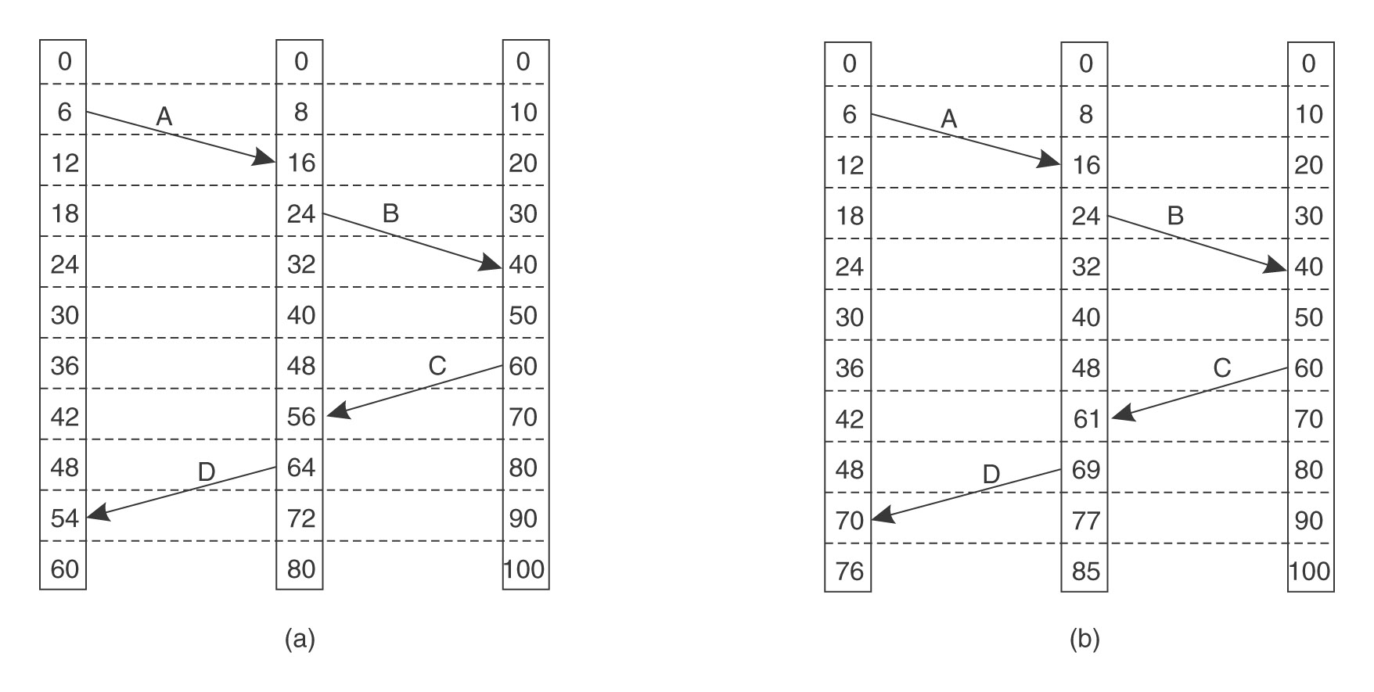
Lamport Timestamps
3 processes, each with its own clock. The clocks run at different rates.
Lamport's algorithm corrects the clocks.
BCSE-IV 2nd Sem
Distributed Computing

Slide 34
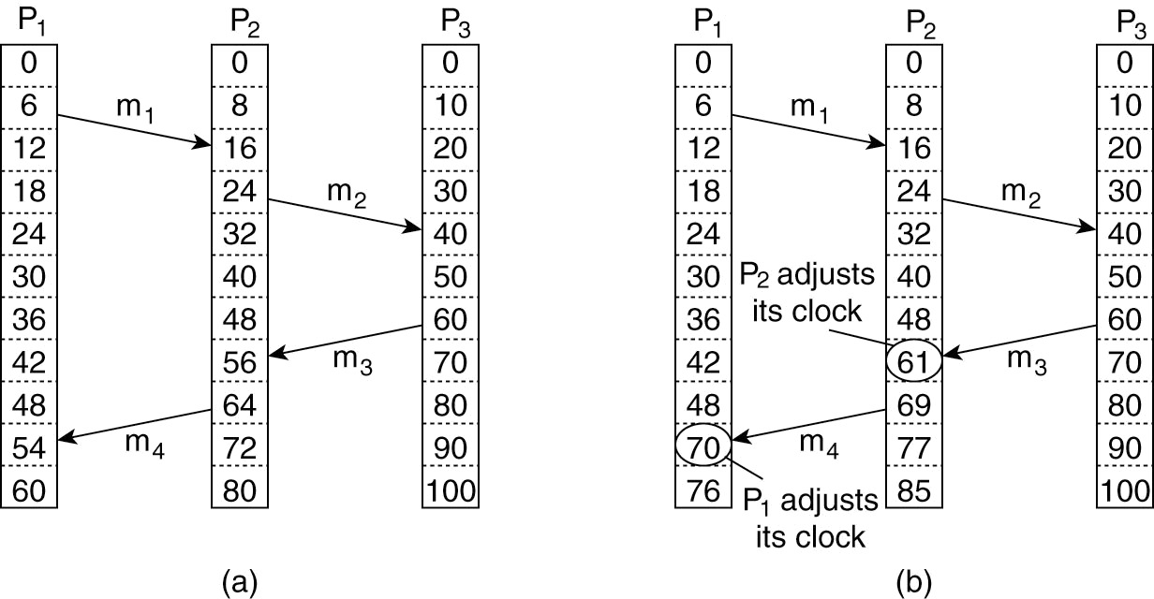
Three processes, each with its own clock. The clocks run at different rates.
  What happens if we print a debug message after sending and receiving m3?
  It will seem like the reception happened before the transmission.
After receiving a message, adjust clock if necessary.
BCSE-IV 2nd Sem
Distributed Computing

Slide 35
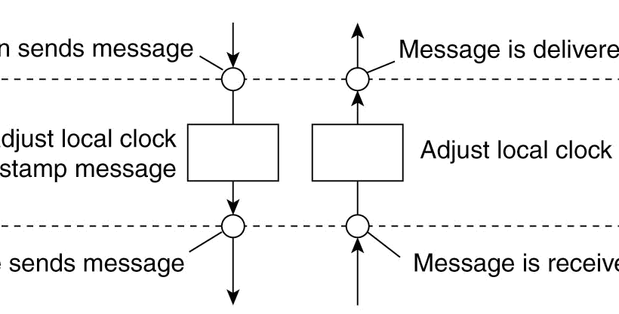
Logical Clocks Layering
The positioning of Lamport’s logical clocks in distributed systems.
Application sends message
Application layer
Message is delivered to application
Middleware layer
Adjust local clock and timestamp message
Adjust local clock
Middleware sends message
Message is received
Network layer
BCSE-IV 2nd Sem
Distributed Computing

Slide 36
Vector Clocks
Lamport’s clocks have the property that if A → B, then C(A) < C(B).
How about the converse? If C(A) < C(B), then does A → B?
Problem: Lamport’s clocks provide a total ordering, even where it shouldn’t.
  Vector clocks address this issue.
BCSE-IV 2nd Sem
Distributed Computing

Slide 37
Vector clocks
The main shortcoming of Lamport’s clocks is that L(a) < L(b) does not imply a → b; hence, we cannot deduce causal dependencies from time stamps.
This problem can be solved by moving from scalar clocks to vector clocks, where each process maintains a vector clock Vi.
  Vi is a vector of size N, where N is the number of processes.
  The component Vi[j] contains the process pi’s knowledge about pj’s clock. Initially, we have Vi[j] := 0 for i, j ∈ {1, . . . ,N}. Clocks are advanced as follows:
    Before pi timestamps an event, it executes Vi[i] := Vi[i] + 1.
    Whenever a message m is sent from pi to pj :
      Process pi executes Vi[i] := Vi[i] + 1 and sends Vi with m.
      Process pj receives Vi with m and merges the vector clocks Vi and Vj as follows:
Vj [k] := max(Vj [k], Vi[k]) + 1 , if j = k (as in scalar clocks)
max(Vj [k], Vi[k]) , otherwise.
  This last part ensures that everything that subsequently happens at pj is now causally related to everything that previously happened at pi.
BCSE-IV 2nd Sem
Distributed Computing

Slide 38
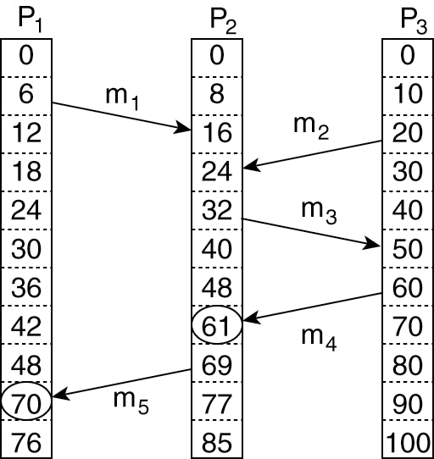
Concurrent Transmissions with VC
T_{snd}(m₁) = (6,0,0)
T_{rcv}(m₁) = (6,16,0)
T_{snd}(m₂) = (0, 0, 20)
BCSE-IV 2nd Sem
Distributed Computing

Slide 39
Global State
Determining global properties in a distributed system is often difficult, but crucial for some applications. For example,
  In distributed garbage collection, we need to be able to determine for some object whether it is referenced by any other objects in the system.
  Deadlock detection requires detection of cycles of processes infinitely waiting for each other.
  To detect the termination of a distributed algorithm we need to obtain simultaneous knowledge of all involved process as well as take account of messages that may still traverse the network.
In other words, it is not sufficient to check the activity of all processes. Even if all processes appear to be passive, there may be messages in transition that, upon arrival, trigger further activity.
Now, we are concerned with determining stable global states or properties that, once they occur, will not disappear without outside intervention. For example, once an object is no longer referenced by any other object (i.e., it may be garbage collected), no reference to the object can appear at a later time.
BCSE-IV 2nd Sem
Distributed Computing

Slide 40
Consistent Cuts
To reason about the validity of global observations—i.e., observations that combine information from multiple nodes—the notion of consistent cuts is useful.
Due to the lack of global time, we cannot simply require that all local observations must happen at the same time.
As it is clear that using the state of the individual processes at arbitrary points in time is not generally going to result in a consistent overall picture, we need to define a criterion for determining when we regard a collection of local states to be globally consistent.
BCSE-IV 2nd Sem
Distributed Computing

Slide 41
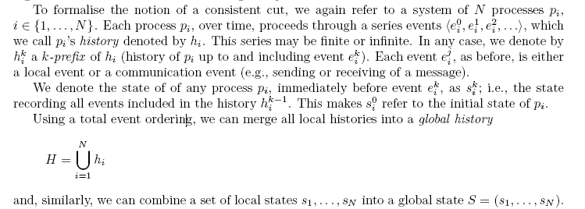
BCSE-IV 2nd Sem
Distributed Computing

Slide 42
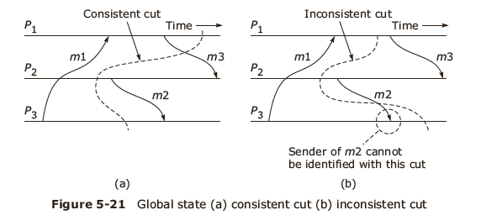
Cuts
This raises the question as to which combination of local states is consistent (a global state is consistent if for any received message in the state the corresponding send is also in the state).
To answer this question, we need one more concept, namely that of a cut. Similar to the global history, we can define cuts based on k-prefixes:
Cut1→ Consistent cut
Cut2→ Inconsistent cut
For the inconsistent cut note that the event that happened before r1 1 (i.e., s1 3) is not part of the cut.
We call a cut consistent iff for all events e′ ∈C, e → e′ implies e ∈ C (i.e., all events that happened before are also in the cut). A global state is consistent if it corresponds to a consistent cut. As a result, we can characterize the execution of a system as a sequence of consistent global states S0 → S1 → S2 → …..
A global history that is consistent with the happened-before relation → is also called a linearization or consistent run. A linearization only passes through consistent global states. Finally, we call a state S′ is reachable from state S if there is a linearization that passes thorough S and then S′.
BCSE-IV 2nd Sem
Distributed Computing

Slide 43
Distributed Concurrency Control
Some of the issues encountered when looking at concurrency in distributed systems are familiar from the study of operating systems and multithreaded applications.
In particular dealing with race conditions that occur when concurrent processes access shared resources.
In non-distributed system these problems are solved by implementing mutual exclusion using local primitives such as locks, semaphores, and monitors.
In distributed systems, dealing with concurrency becomes more complicated due to the lack of directly shared resources (such as memory, CPU registers, etc.), the lack of a global clock, the lack of a single global program state, and the presence of communication delays.
BCSE-IV 2nd Sem
Distributed Computing

Slide 44
Distributed Mutual Exclusion
When concurrent access to distributed resources is required, we need to have mechanisms to prevent race conditions while processes are within critical sections.
These mechanisms must fulfill the following three requirements:
  Safety: At most one process may execute the critical section at a time
  Liveness: Requests to enter and exit the critical section eventually succeed
  Ordering: Requests are processed in happened-before ordering
BCSE-IV 2nd Sem
Distributed Computing

Slide 45
Method 1: Central Server
The simplest approach is to use a central server that controls the entering and exiting of critical sections.
  Processes must send requests to enter and exit a critical section to a lock server (or coordinator), which grants permission to enter by sending a token to the requesting process.
  Upon leaving the critical section, the token is returned to the server.
  Processes that wish to enter a critical section while another process is holding the token are put in a queue.
  When the token is returned the process at the head of the queue is given the token and allowed to enter the critical section.
This scheme is easy to implement, but it does not scale well due to the central authority. Moreover, it is vulnerable to failure of the central server.
BCSE-IV 2nd Sem
Distributed Computing

Slide 46
Method 2: Token Ring
More sophisticated is a setup that organizes all processes in a logical ring structure, along which a token message is continuously forwarded.
Before entering the critical section, a process has to wait until the token comes by and then retain the token until it exits the critical section.
Disadvantages of this approach
  the ring imposes some delay before entry (0 to N-1), which again limits scalability.
  the token messages consume bandwidth and failing nodes or channels can break the ring.
  Another problem is that failures may cause the token to be lost.
  In addition, if new processes join the network or wish to leave, further management logic is needed.
BCSE-IV 2nd Sem
Distributed Computing

Slide 47
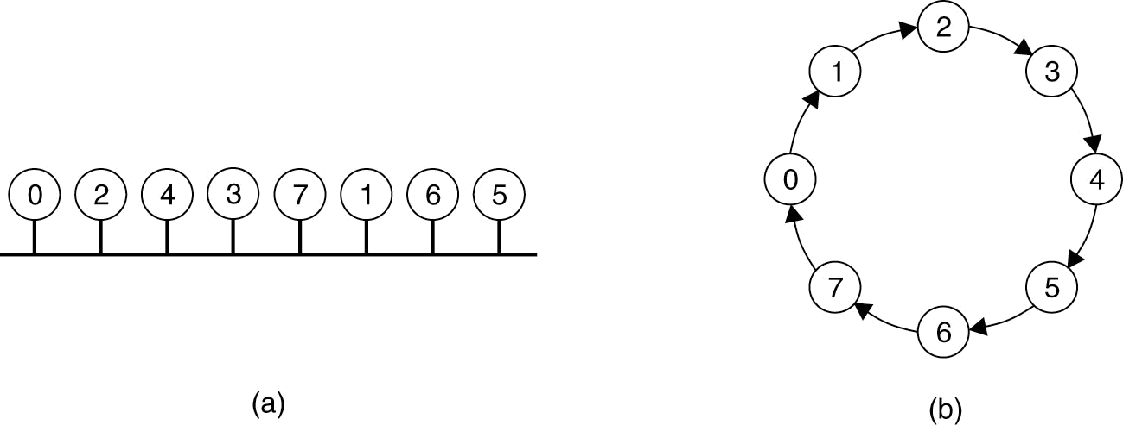
A Token Ring Algorithm
When ring is initiated, give process 0 the token.
Token circulates around the ring in point-to-point messages.
When a process wants to enter the CS, it waits till it gets the token, enters, holds the token, exits, passes the token on.
Starvation?
Lost tokens? How can we detect that token is lost?
Other crashes?
An unordered group of processes on a bus network.
A logical ring constructed in software.
BCSE-IV 2nd Sem
Distributed Computing

Slide 48
When ring is initiated, give process 0 the token.
Token circulates around the ring in point-to-point messages.
When a process wants to enter the CS, it waits till it gets the token, enters, holds the token, exits, passes the token on.
BCSE-IV 2nd Sem
Distributed Computing

Slide 49
Method 3: Using Multicast and Logical Clocks
Each participating process pi maintains a Lamport clock and all processes must be able to communicate pairwise. At any moment, each process is in one of three states:
  Released: Outside of critical section
  Wanted: Waiting to enter critical section
  Held: Inside critical section
If a process wants to enter a critical section, it multicasts a message <Li, pi> and waits until it has received a reply from every other process.
The processes operate as follows:
  If a process is in Released state, it immediately replies to any request to enter the critical section.
  If a process is in Held state, it delays replying until it is finished with the critical section.
  If a process is in Wanted state, it replies to a request immediately only if the requesting timestamp is smaller than the one in its own request.
BCSE-IV 2nd Sem
Distributed Computing

Slide 50
Election algorithms

Slide 51
Introduction
Goals
  Attempt to locate the process with the highest process number and designate it as the coordinator and tell all the active processes about this coordinator.
  To allow a recovered leader to re-establish control (or at least, to identify the current leader).
Algorithms
  Bully algorithm
  Ring algorithm

Slide 52
The Bully algorithm
Messages
  Election (E)—announce an election
  Reply (R) — acknowledge election msg.
  Coordinator ( C) — announce new coordinator

Slide 53
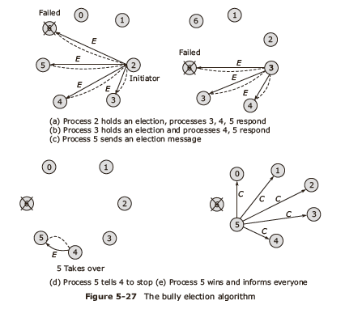
Bully algorithm - example
0

Slide 54
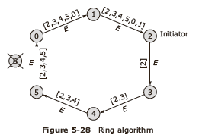
Token Ring algorithm
Messages
  Election (E)—announce an election, is token message
  Coordinator ( C) — announce new coordinator

Slide 55
Comparison
Bully algorithm
N–2 messages in best case
O(N²) messages in worst case
Ring algorithm
3N–1 messages in worst case
N–1 election messages to reach immediate neighbour in wrong direction, N election messages to elect it, then N elected messages to announce result

Slide 56
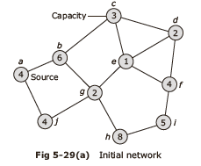
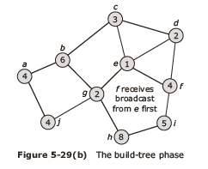
Election in a Wireless Network-1

Slide 57
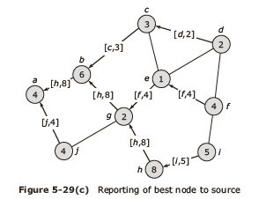
Election in a Wireless Network-2

